Slide 1
Week 5 (3) – Introduction to Divide and Conquer
CST370 – Design & Analysis of Algorithms
Dr. Byun
Computer Science

Slide 2
Lecture Objectives
After completion of this lecture, you will be able to
  explain the basic idea of divide-and-conquer technique.
  use Master Theorem to determine the time efficiency of divide-and-conquer algorithms.
Note that we cover Chapter 5 first. We will then cover Chapter 4.

Slide 3
Chapter 5: Divide-and-Conquer
5.1 Mergesort
5.2 Quicksort
5.3 Binary Tree Traversals and Related Properties
5.4 Multiplication of Large Integers and Strassen’s Matrix Multiplication
5.5 The Closest-Pair and Convex-Hull Problems by Divide-and-Conquer

Slide 4
Introduction to Divide and Conquer
Divide-and-conquer is one of the best-known problem solving techniques.
Read the following document to get the basic idea of it with an example.
  https://goo.gl/ySZavW

Slide 5
Master Theorem
Master theorem is very useful to analyze the time efficiency of divide-and-conquer algorithms.
Read the following document to get the basic idea of the theorem.
  https://goo.gl/zktCvU

Slide 6
<<< Course Instruction >>>
Read pages 169-171 in the textbook and proceed to the next slide.
  Basic concept of divide-and-conquer must be clearly understood.
  Master theorem is very useful to analyze the time efficiency of divide-and-conquer algorithms. You should be able to use it to get the time complexity of a divide-and-conquer algorithm.

Slide 7
Puzzle: Predicting a Finger Count
A little girl counts from 1 to 1000 using the fingers of her left hand as follows.
  She starts by calling her thumb 1, the first finger 2, middle finger 3, ring finger 4, and little finger 5.
  Then she reverses direction, calling the ring finger 6, middle finger 7, the first finger 8, and her thumb 9, after which she calls her first finger 10, and so on.
If she continues to count in this manner (to 1000), on which finger will she stop?

Slide 8
Important Note
Do not see the answer immediately on the next page.
Hint
  Reenact the girl’s count long enough to see a pattern that makes the answer obvious.

Slide 9
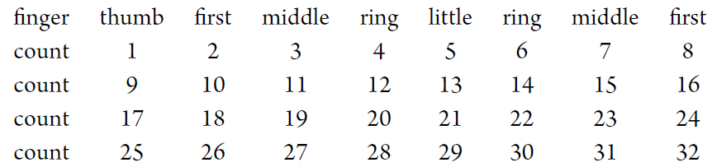
Solution
She will stop on her first finger.
Here is how the finger count starts:
It is easy to see that the counting falls on the same finger every eighth number called. Therefore to answer the question, all one needs is to find the remainder of the division of 1000 by 8, which is equal to 0.
This implies that when the girl reaches 1000, she will be on her first finger (moving from the middle finger), the same one she will be on while calling any number divisible by 8.

Slide 10
<<< Course Instruction >>>
This lecture is over.
  When you are done, study the next lecture (week_5_4.ppt) on the iLearn.

